Slide 1
Applying AI with Python
Alex Conway
alex@numberboost.com

Slide 2
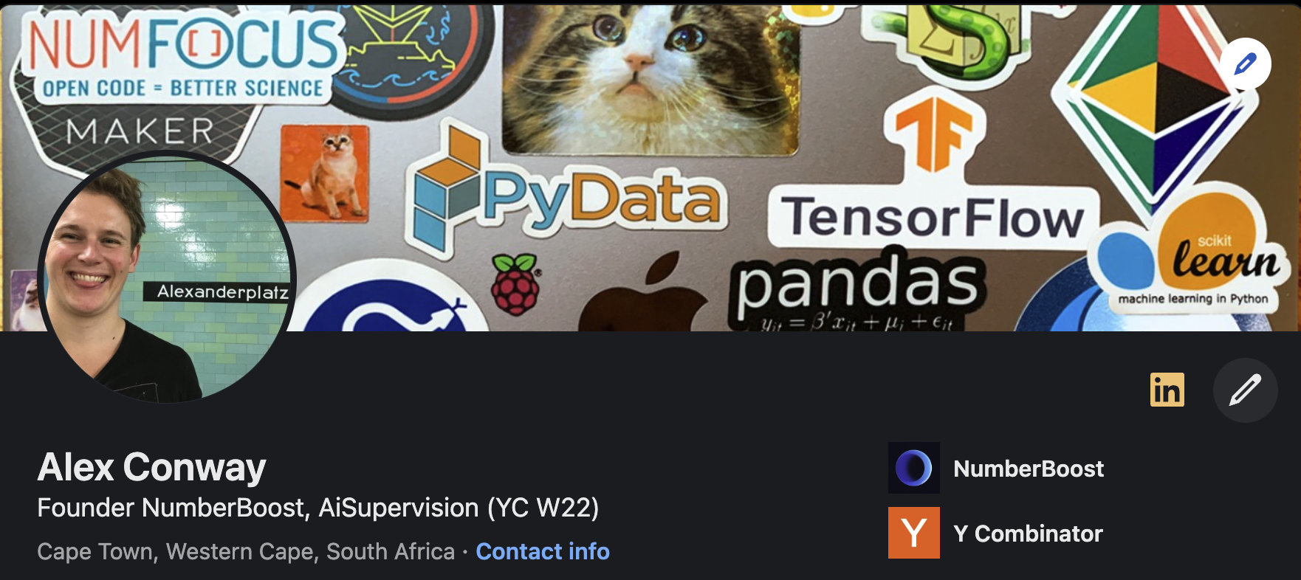
x.com/alxcnwy linkedin.com/in/alxcnwy/

Slide 3
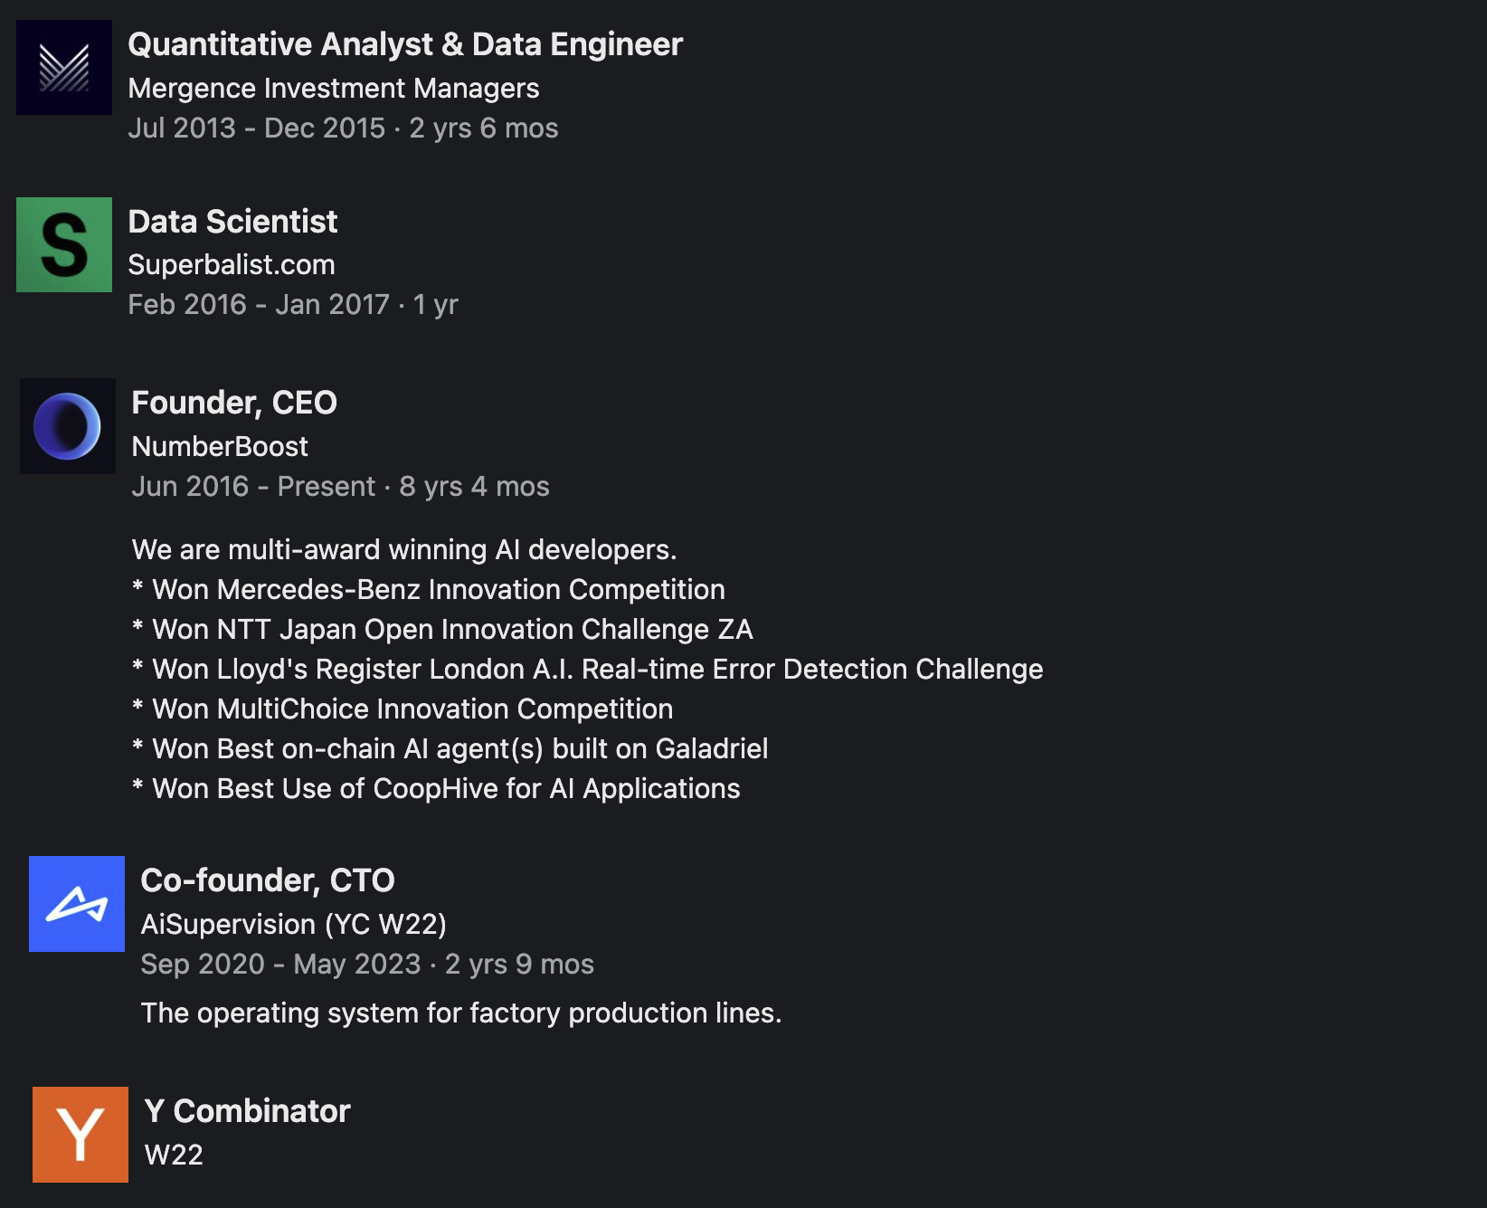

Slide 4
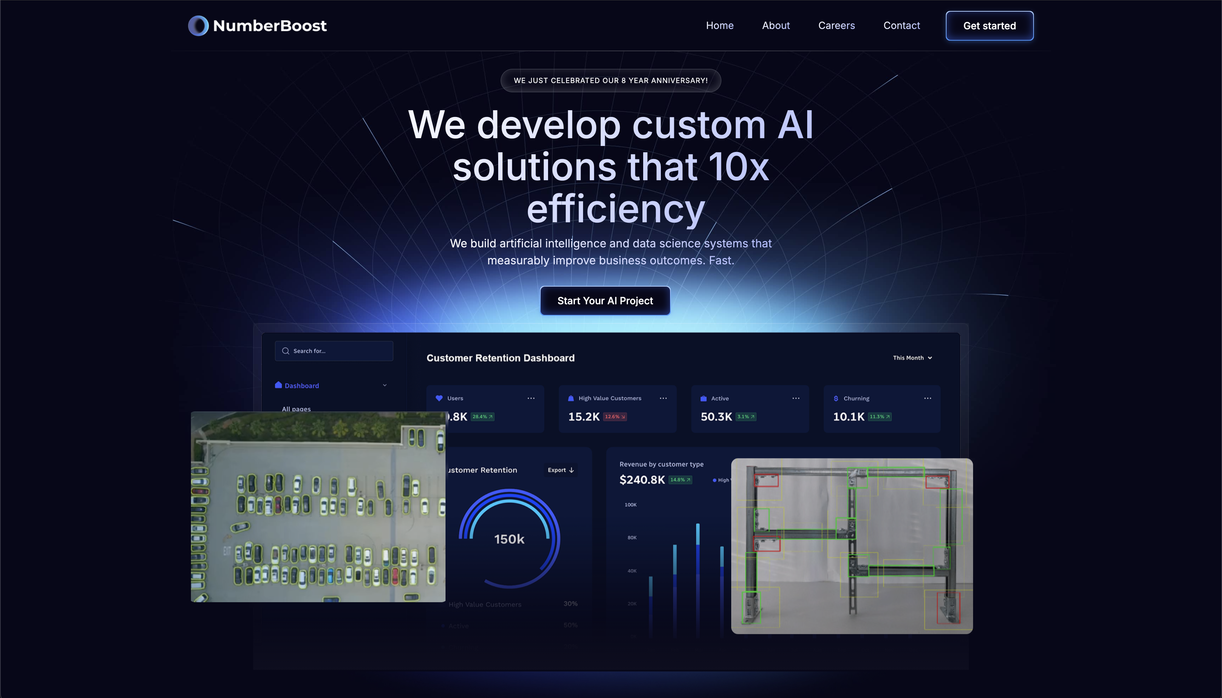

Slide 5

What is Artificial Intelligence (AI)?

Slide 6
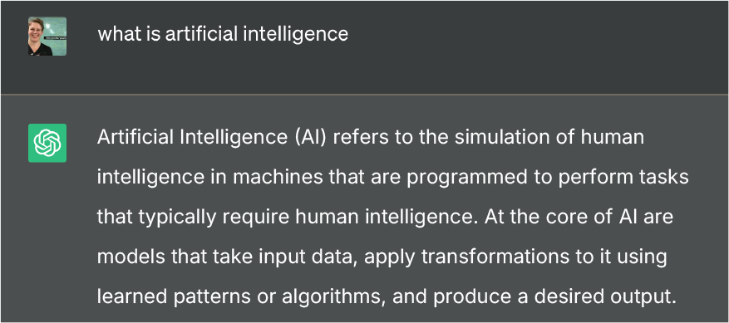

Slide 8

def ai_model(input):
#
# algorithms f(input) = output
#
return output

Slide 9
def ai_model(input):
#
# algorithms f(input) = output
#
return output

Slide 10
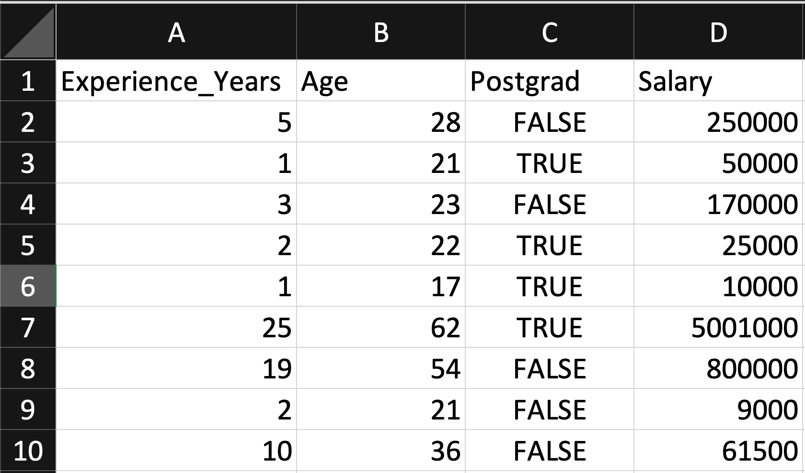
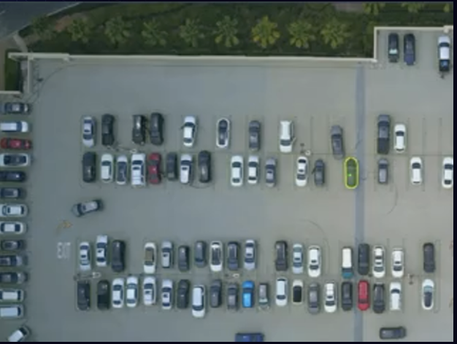
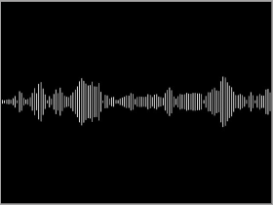
Input
Table
Image / Video
Artificial Intelligence (AI) is transforming industries and our lives by enabling computers to solve increasingly complex tasks, and Python stands at the forefront of this revolution. In this talk, we will explore how Python's rich ecosystem of AI libraries and frameworks can be harnessed to
Text
Audio

Slide 11
def ai_model(input):
#
# algorithms f(input) = output
#
return output

Slide 12
Algorithm Terminology
(Supervised) Regression (predict a number)
(Supervised) Classification (predict a category / label)
Unsupervised (find patterns within a dataset without labels)
Generative (create new data / content)

Slide 13
Types of AI Algorithms
Regression (Linear / Polynomial / Logistic, etc.)
Decision Trees (Random Forests, GBMs, etc.)
Clustering (K-Means, Spectral, DBSCAN, etc.)
Neural Networks (Convolutional, Recurrent, Transformer, etc.)
And more…

Slide 14
def ai_model(input):
#
# algorithms f(input) = output
#
return output

Slide 15
Output
Table
Image / Video
Artificial Intelligence (AI) is transforming industries and our lives by enabling computers to solve increasingly complex tasks, and Python stands at the forefront of this revolution. In this talk, we will explore how Python's rich ecosystem of AI libraries and frameworks can be harnessed to
Text
Audio

Slide 16
Output
Table
Image / Video
Artificial Intelligence (AI) is transforming industries and our lives by enabling computers to solve increasingly complex tasks, and Python stands at the forefront of this revolution. In this talk, we will explore how Python's rich ecosystem of AI libraries and frameworks can be harnessed to
Text
Audio

Slide 17
Output
Table
Image / Video
Artificial Intelligence (AI) is transforming industries and our lives by enabling computers to solve increasingly complex tasks, and Python stands at the forefront of this revolution. In this talk, we will explore how Python's rich ecosystem of AI libraries and frameworks can be harnessed to
Text
Audio

Slide 18
Output
Table
Image / Video
Artificial Intelligence (AI) is transforming industries and our lives by enabling computers to solve increasingly complex tasks, and Python stands at the forefront of this revolution. In this talk, we will explore how Python's rich ecosystem of AI libraries and frameworks can be harnessed to
Text
Audio

Slide 19
Output
Table
Image / Video
Artificial Intelligence (AI) is transforming industries and our lives by enabling computers to solve increasingly complex tasks, and Python stands at the forefront of this revolution. In this talk, we will explore how Python's rich ecosystem of AI libraries and frameworks can be harnessed to
Text
Audio

Slide 20
Output
Table
Image / Video
Artificial Intelligence (AI) is transforming industries and our lives by enabling computers to solve increasingly complex tasks, and Python stands at the forefront of this revolution. In this talk, we will explore how Python's rich ecosystem of AI libraries and frameworks can be harnessed to
Text
Audio

Slide 21
Output
Table
Image / Video
Artificial Intelligence (AI) is transforming industries and our lives by enabling computers to solve increasingly complex tasks, and Python stands at the forefront of this revolution. In this talk, we will explore how Python's rich ecosystem of AI libraries and frameworks can be harnessed to
Text
Audio

Slide 22
Output
Table
Image / Video
Artificial Intelligence (AI) is transforming industries and our lives by enabling computers to solve increasingly complex tasks, and Python stands at the forefront of this revolution. In this talk, we will explore how Python's rich ecosystem of AI libraries and frameworks can be harnessed to
Text
Audio

Slide 23
Output
Table
Image / Video
Artificial Intelligence (AI) is transforming industries and our lives by enabling computers to solve increasingly complex tasks, and Python stands at the forefront of this revolution. In this talk, we will explore how Python's rich ecosystem of AI libraries and frameworks can be harnessed to
Text
Audio

Slide 24
Output
Table
Image / Video
Artificial Intelligence (AI) is transforming industries and our lives by enabling computers to solve increasingly complex tasks, and Python stands at the forefront of this revolution. In this talk, we will explore how Python's rich ecosystem of AI libraries and frameworks can be harnessed to
Text
Audio

Slide 25




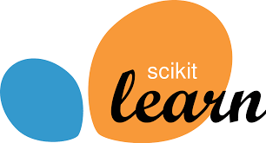



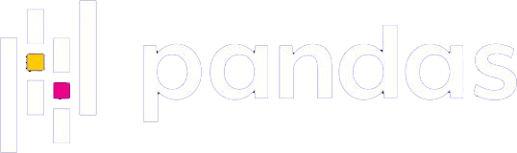
Why Python for AI?
Easy to use (ML researchers typically not software engineers)
Massive community (easy to find answers to questions)
Extensive libraries and frameworks (don’t need to invent to use)

Slide 26
Table Data

Slide 27
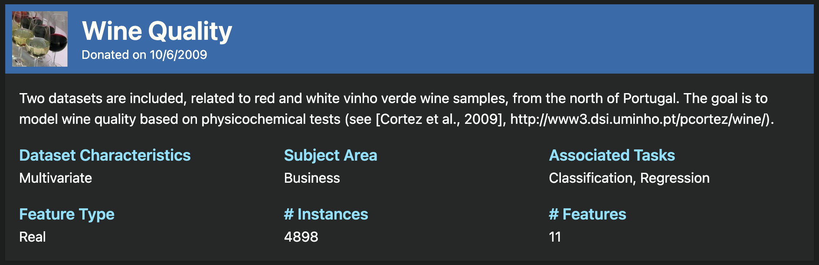
https://archive.ics.uci.edu/dataset/186/wine+quality

Slide 28
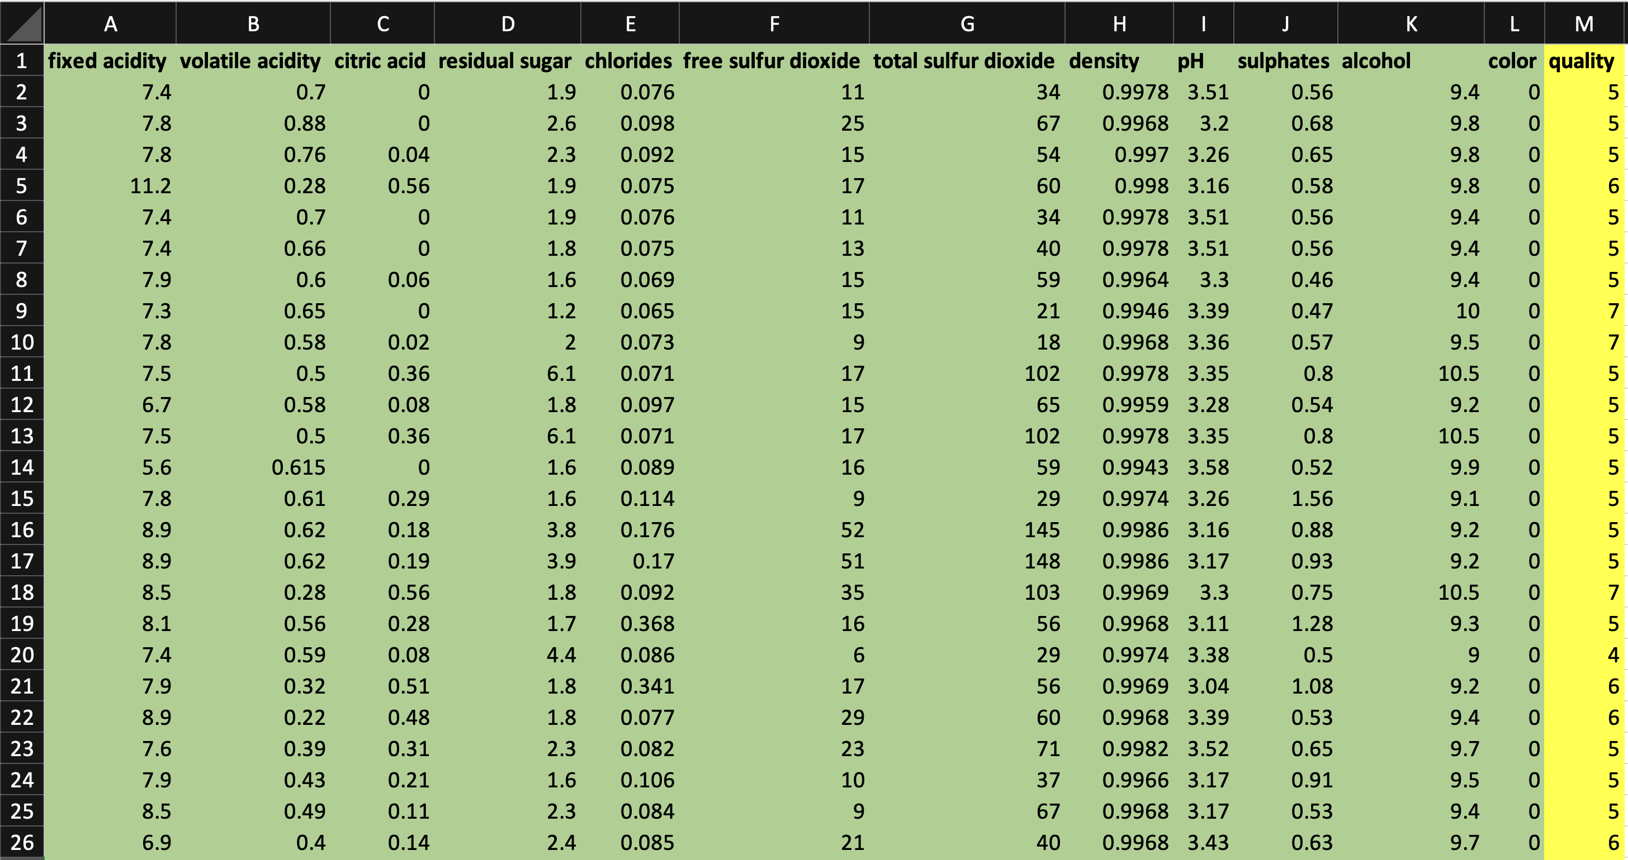
Regression Model
to Predict Wine Quality

Slide 29
Jupyter Notebook
TableData.ipynb

Slide 30
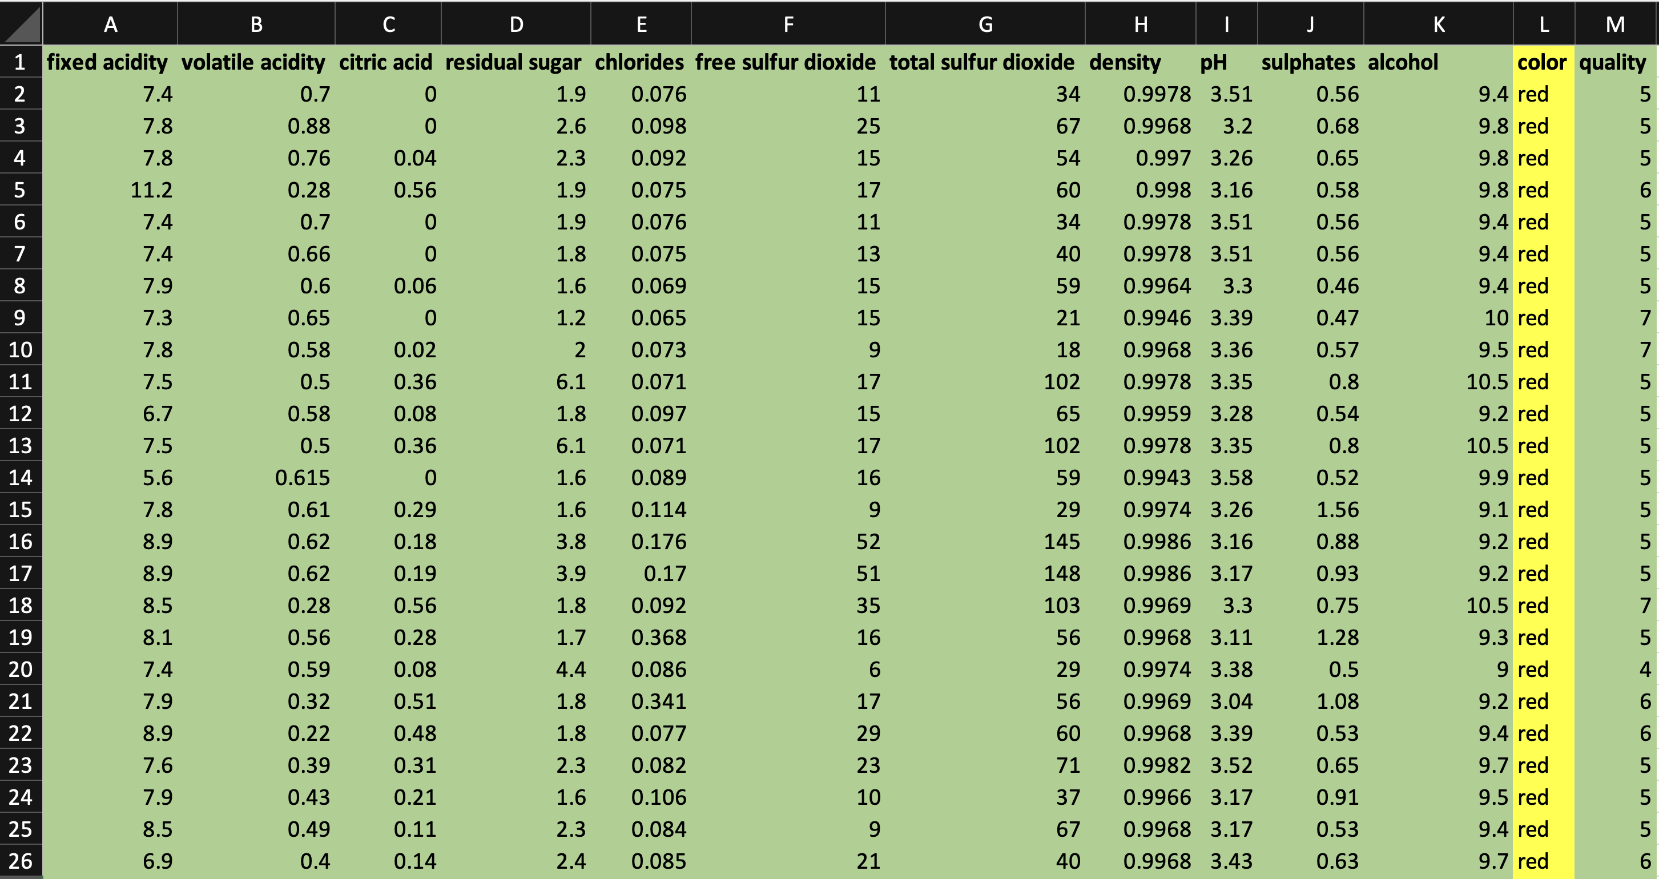
Classification Model
to Predict Wine Colour

Slide 31
Jupyter Notebook
TableData.ipynb

Slide 32
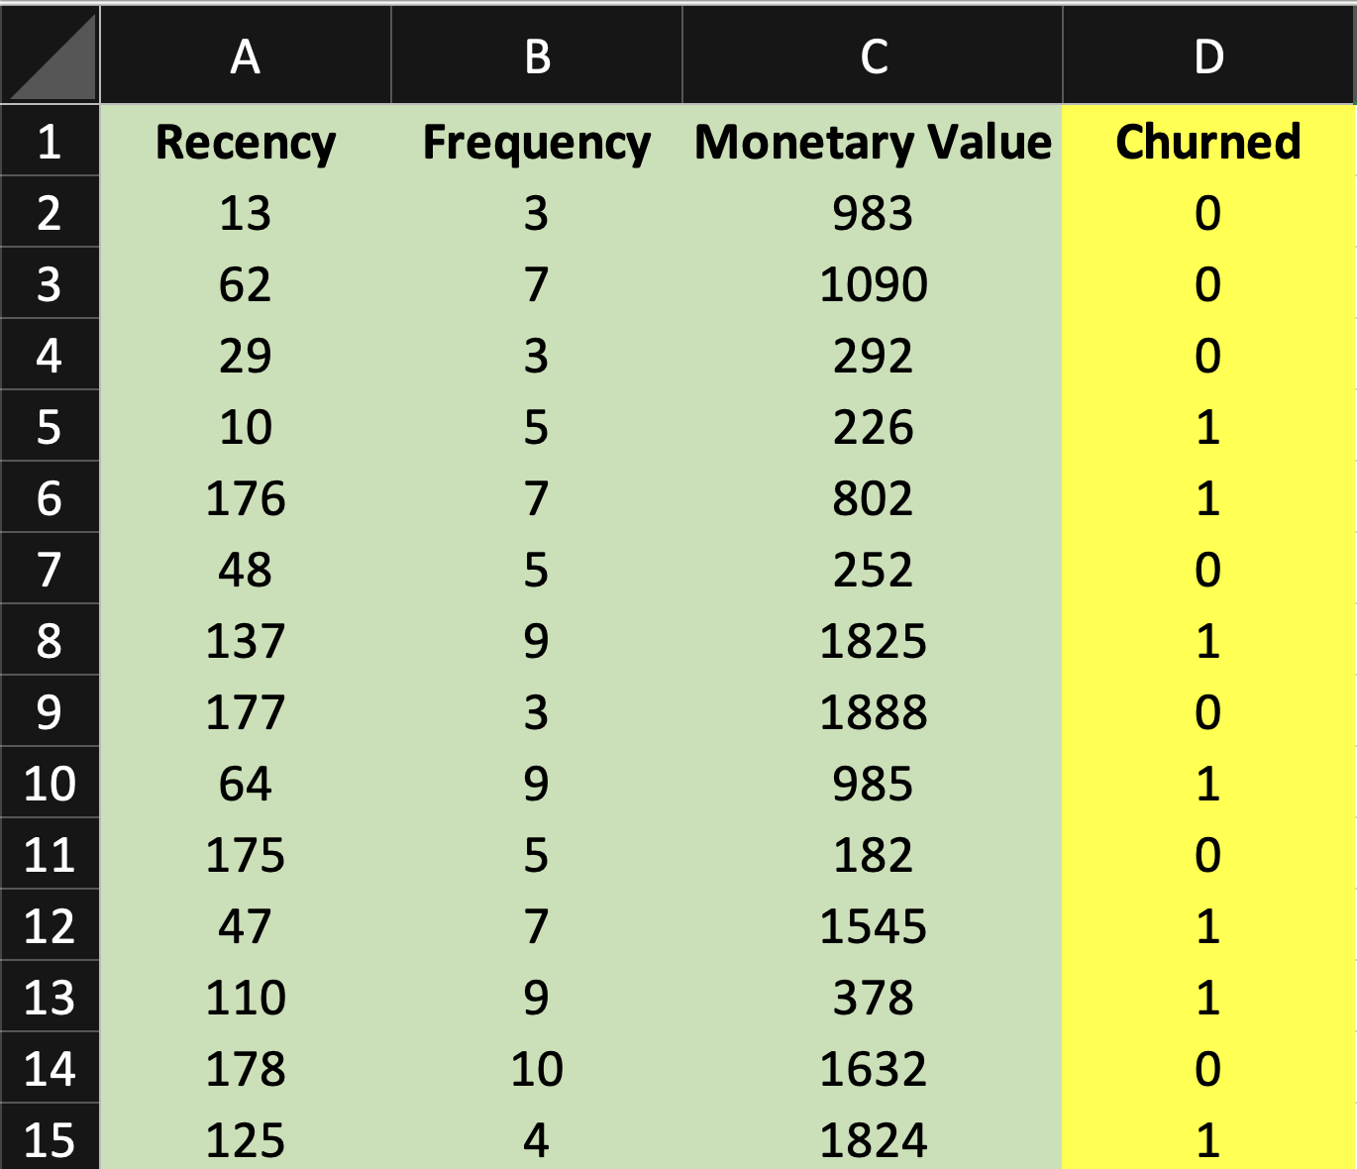

Slide 33
Image / Video Data

Slide 34
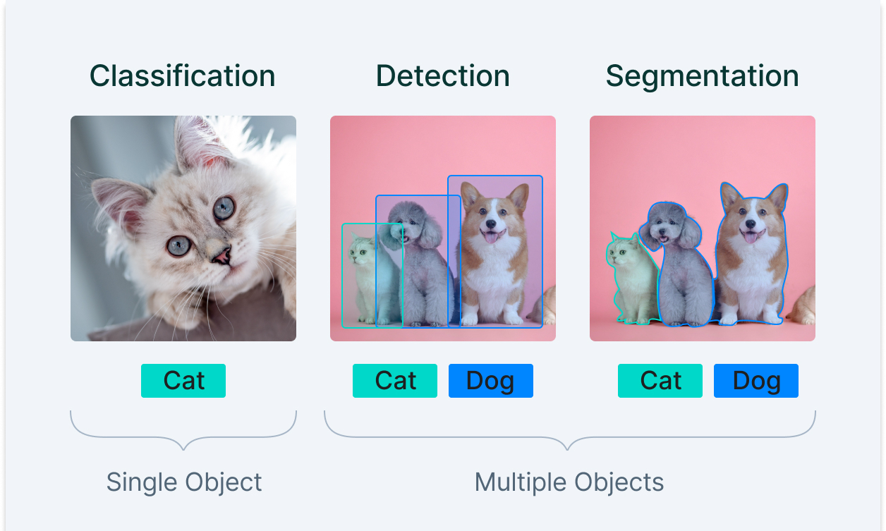

Slide 35
Jupyter Notebook
Classification and Visual Search.ipynb

Slide 36
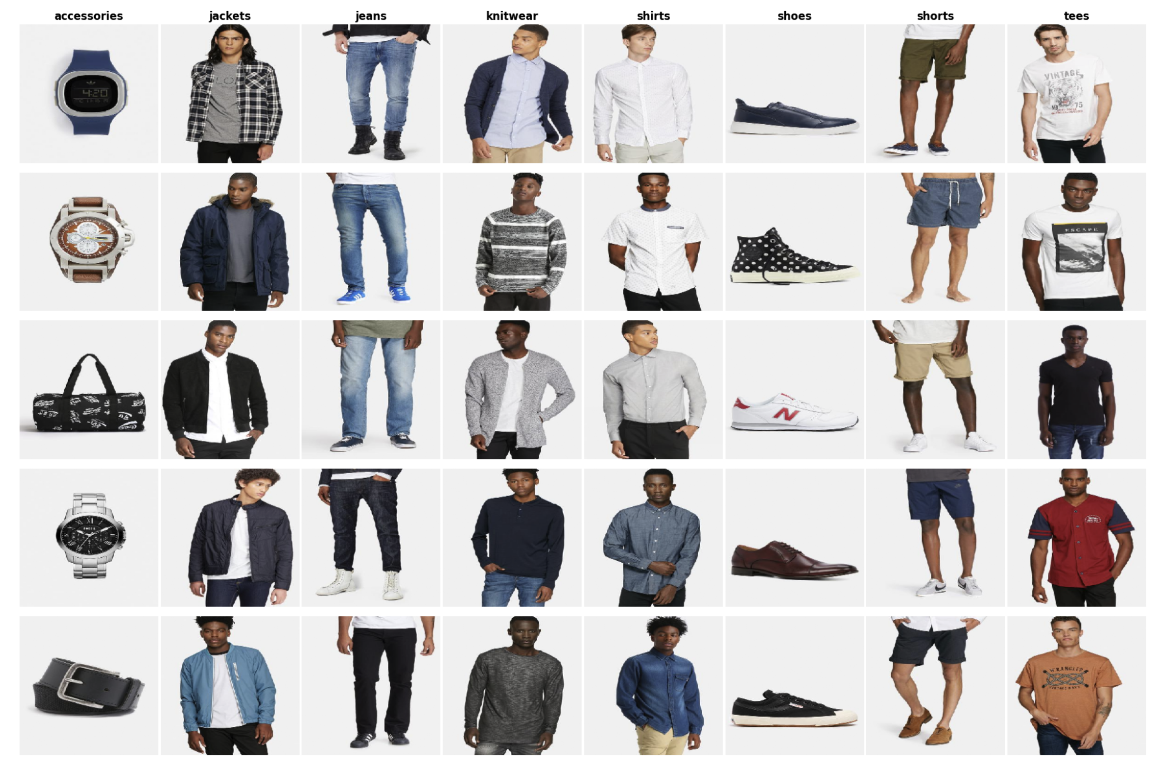

Slide 37
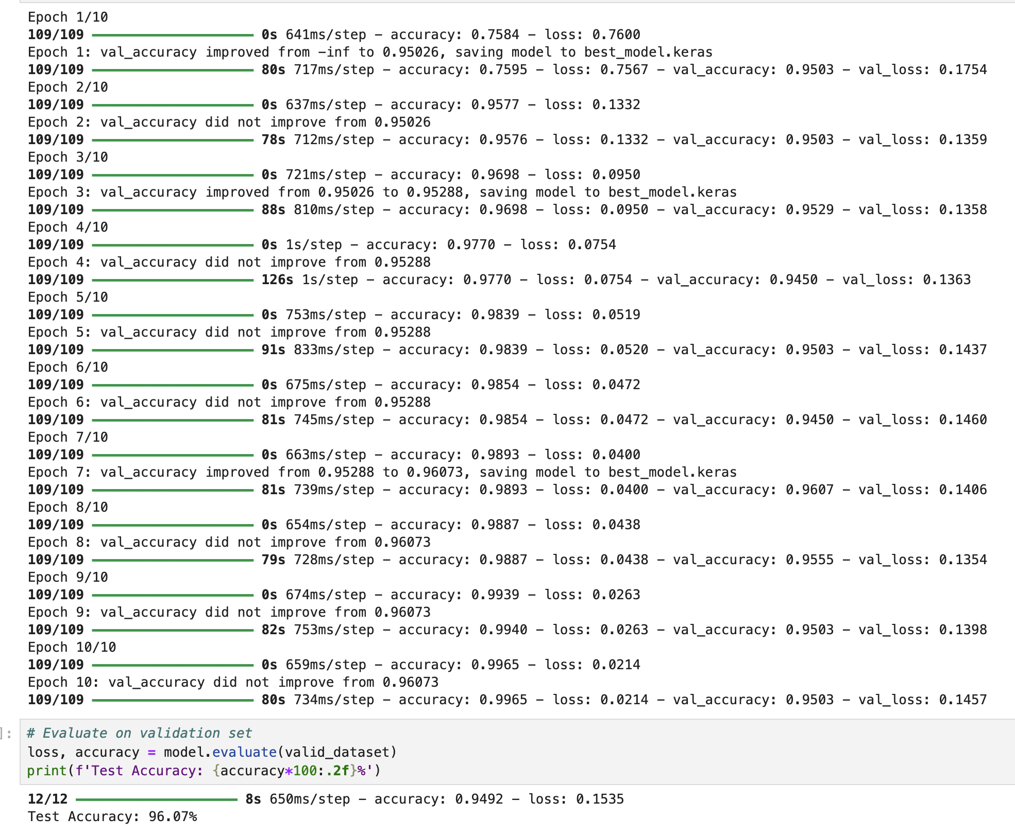

Slide 38
Embeddings
TODO

Slide 39
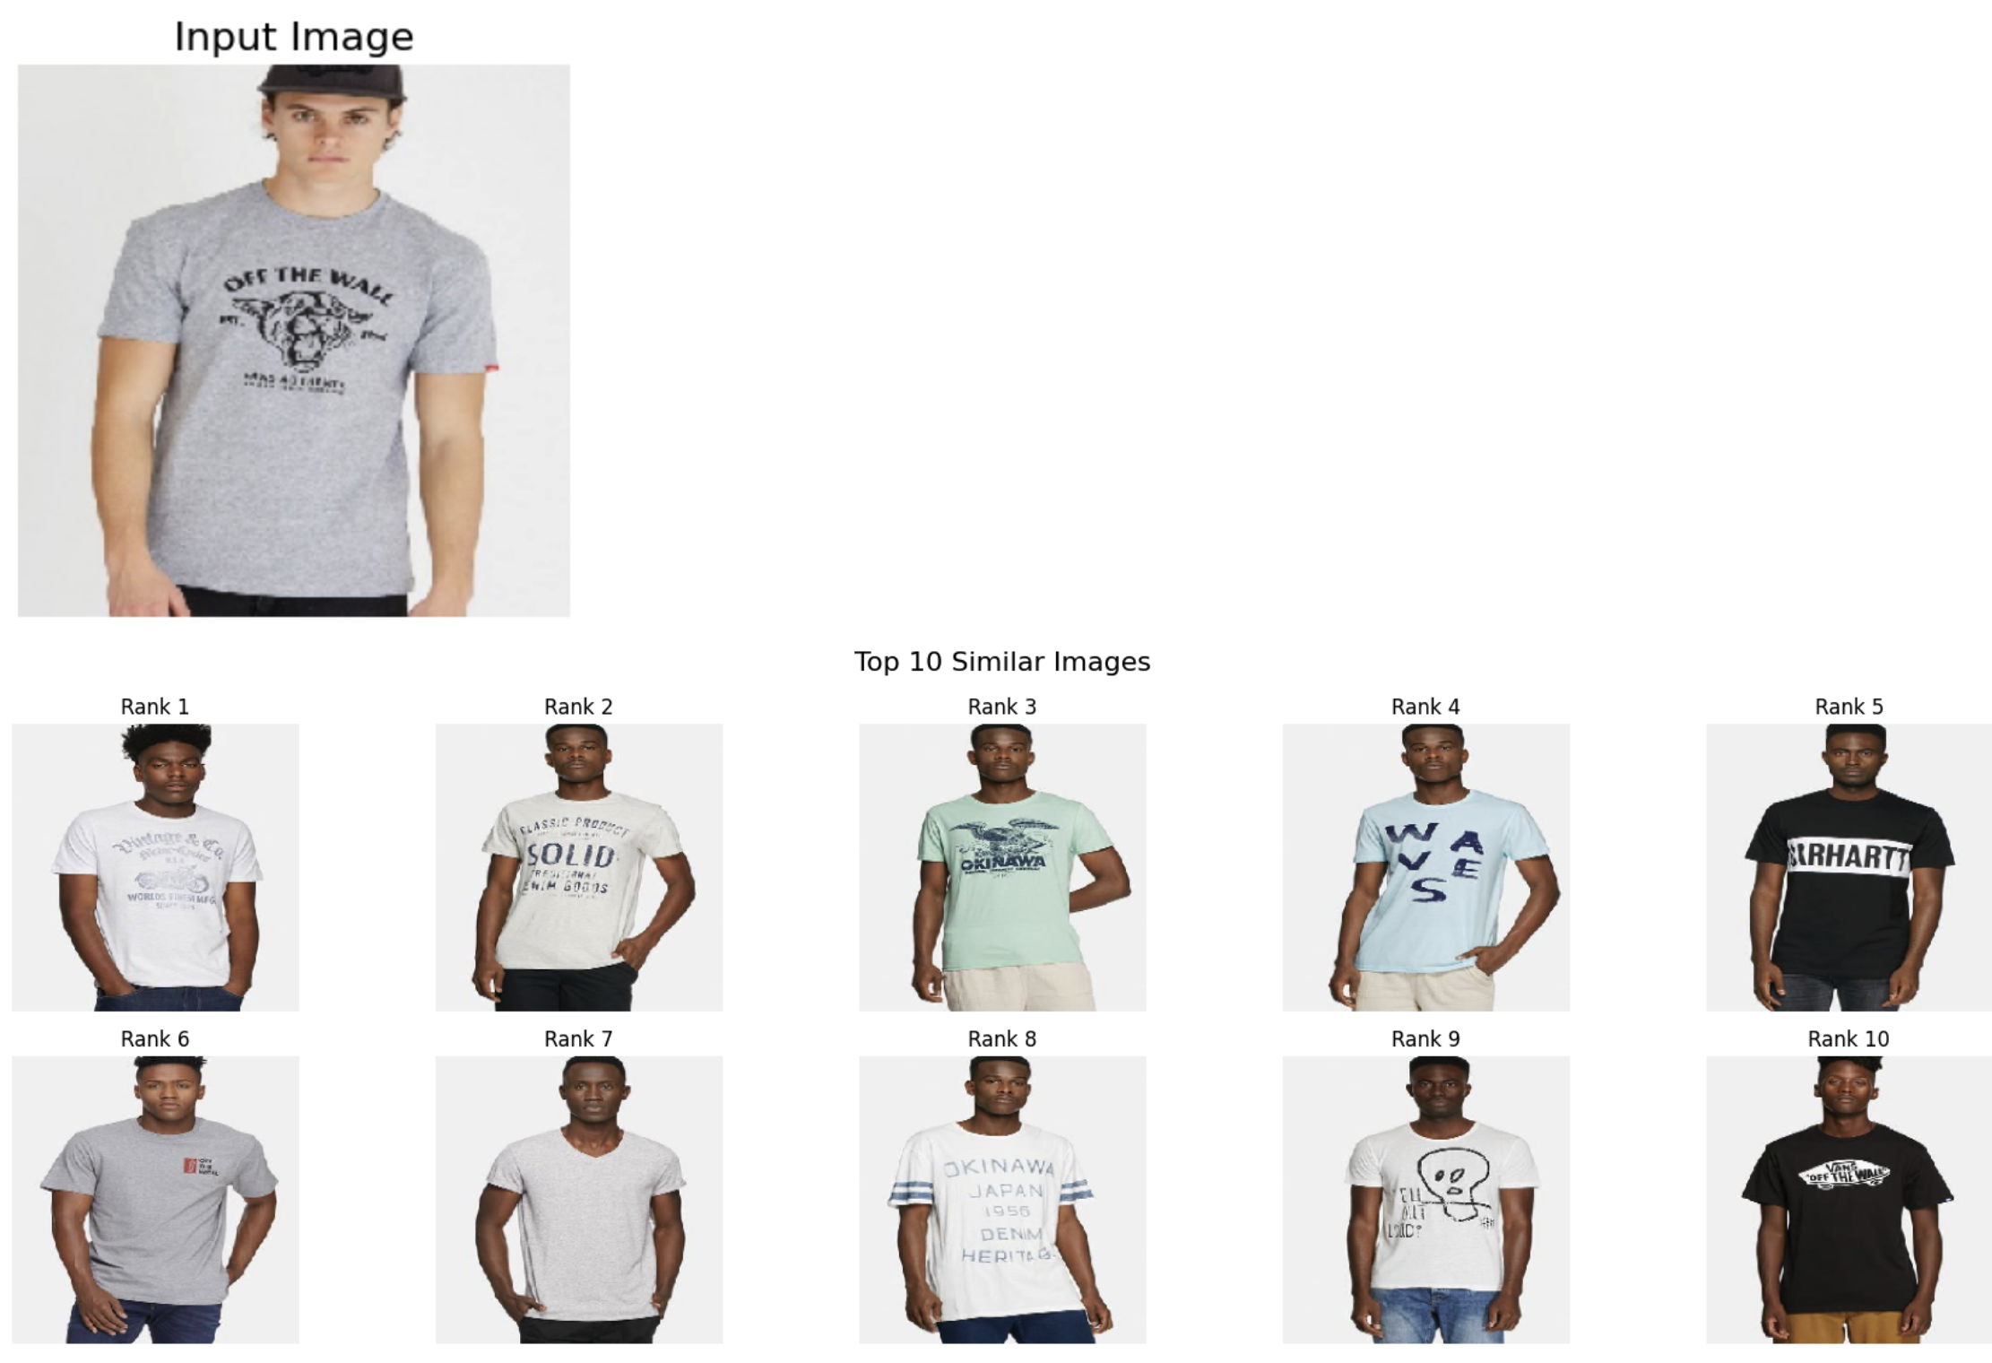

Slide 40
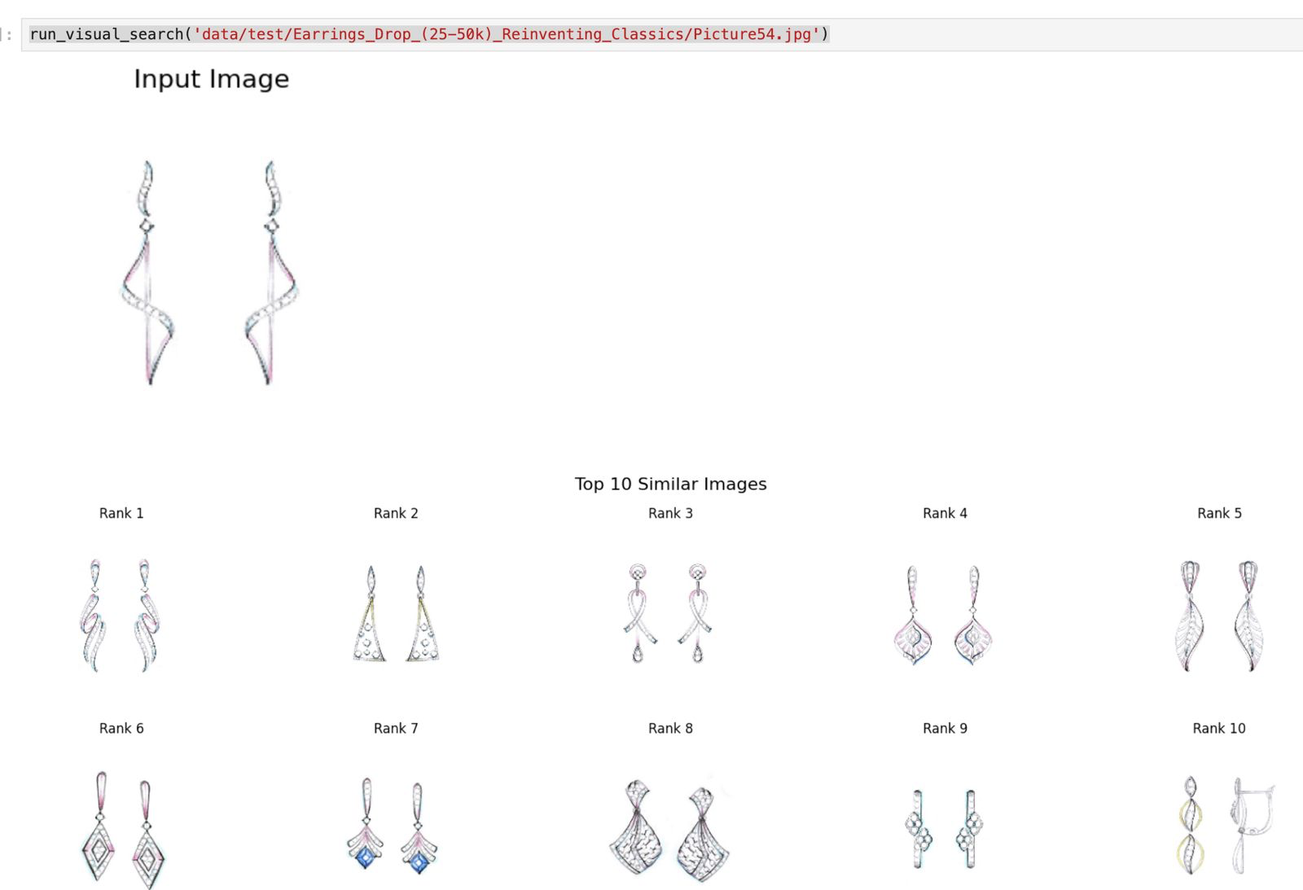

Slide 41


Slide 42
Jupyter Notebook
Object Detection.ipynb

Slide 43
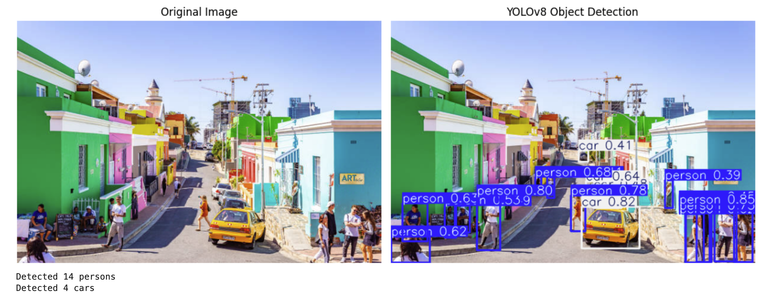

Slide 44

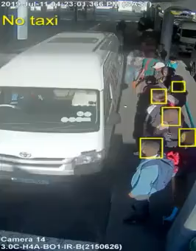

Slide 45
Jupyter Notebook
Segmentation.ipynb

Slide 46
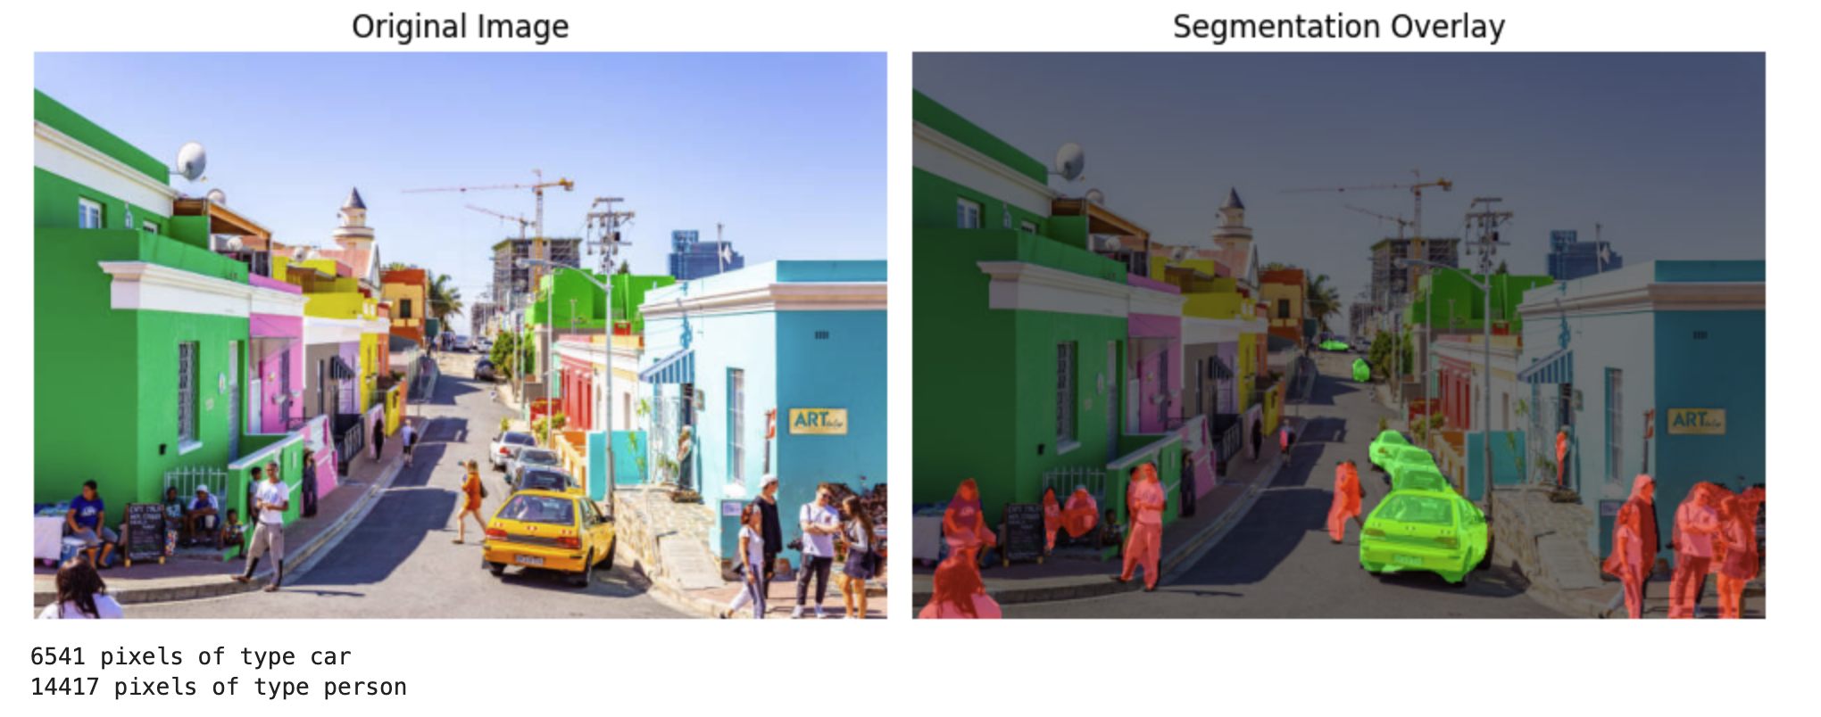

Slide 47
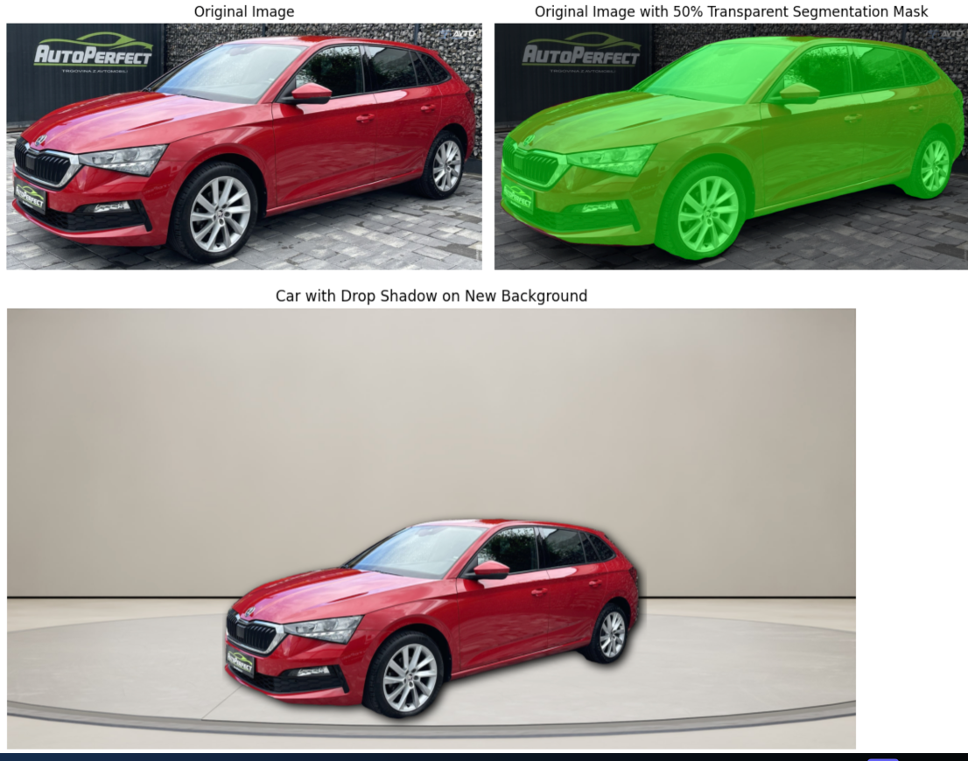

Slide 48
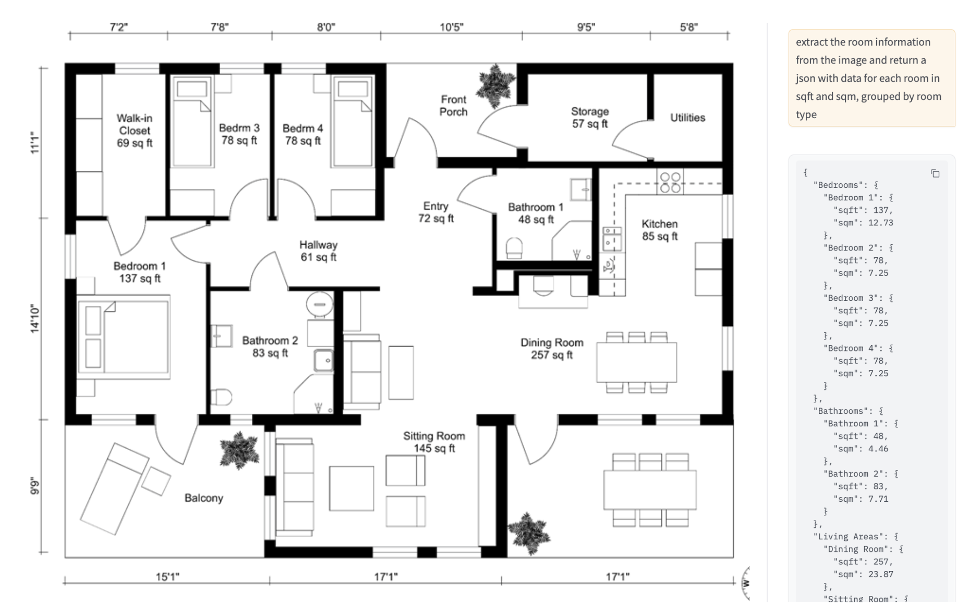

Slide 49
Speech Data

Slide 50
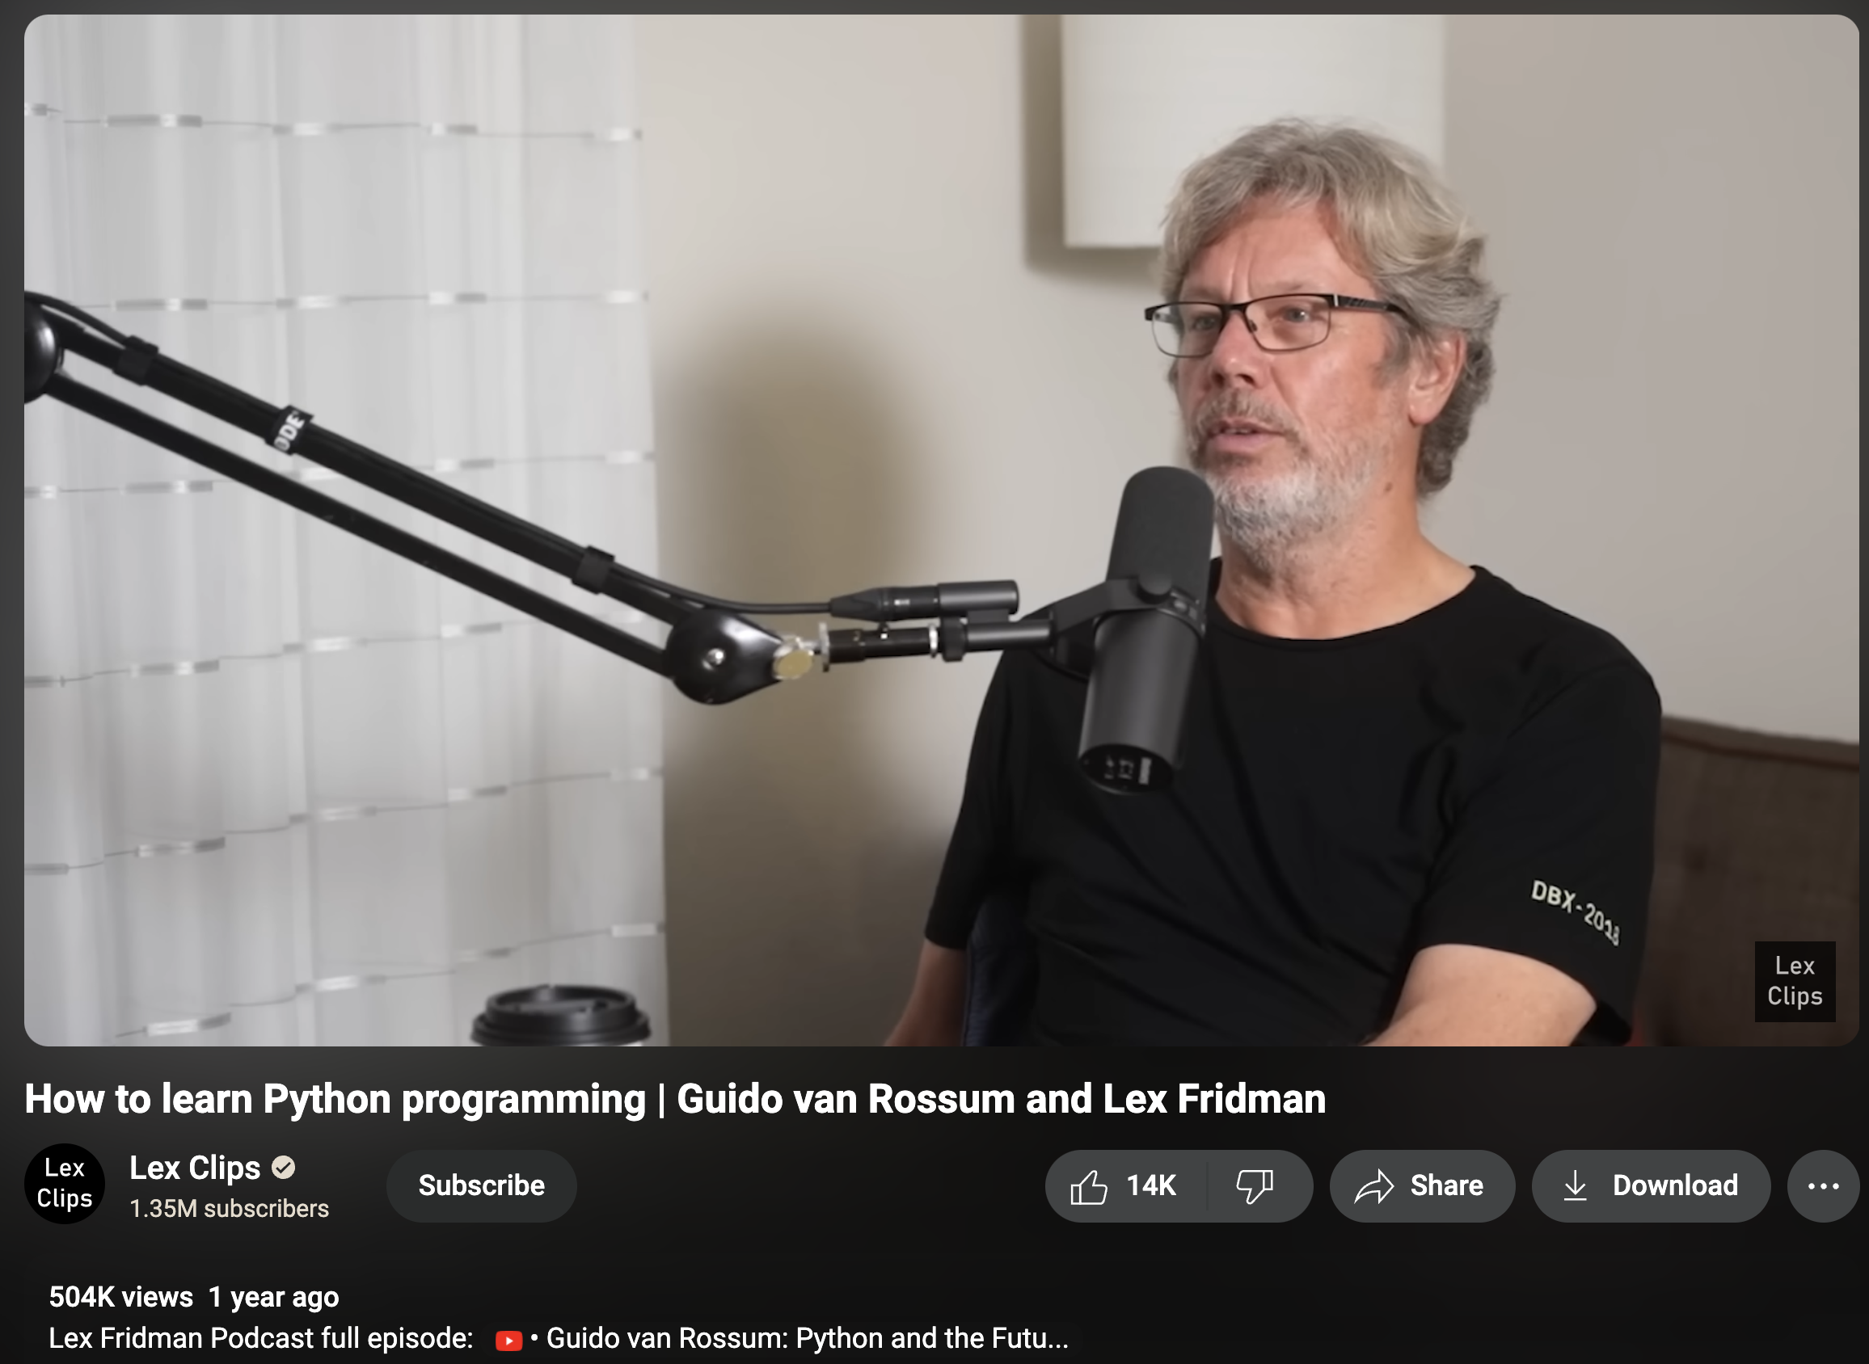

Slide 51
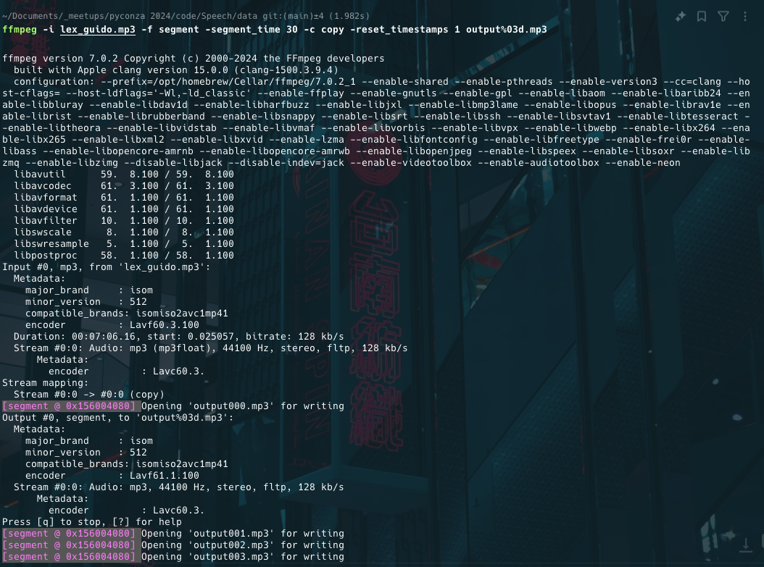

Slide 52
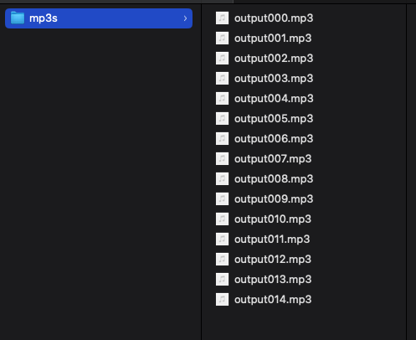

Slide 53
Jupyter Notebook
Transcribe.ipynb

Slide 54
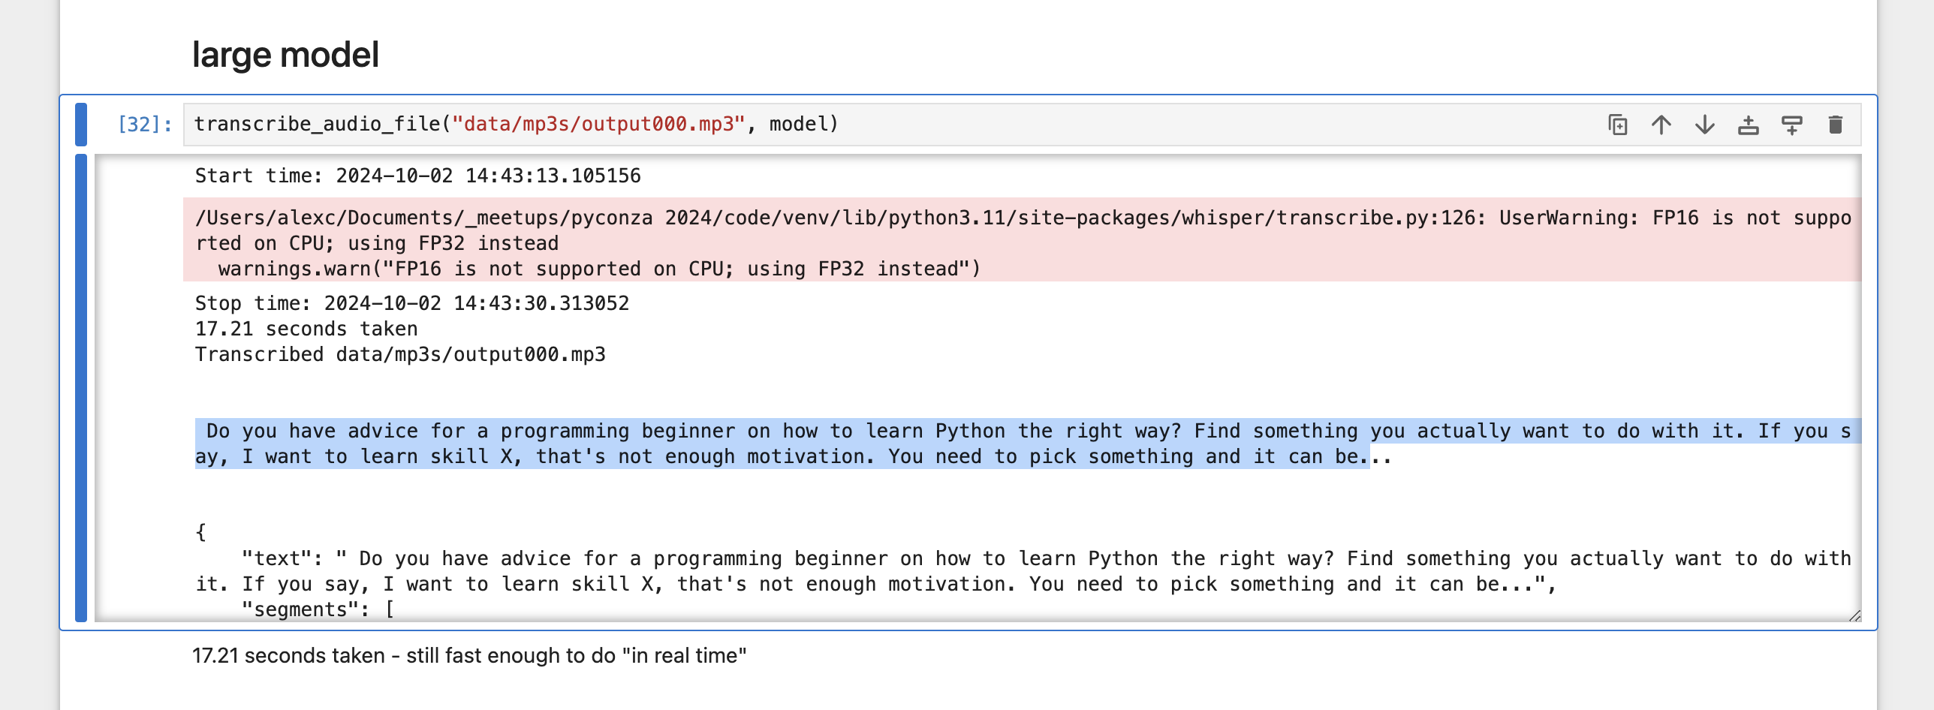

Slide 55
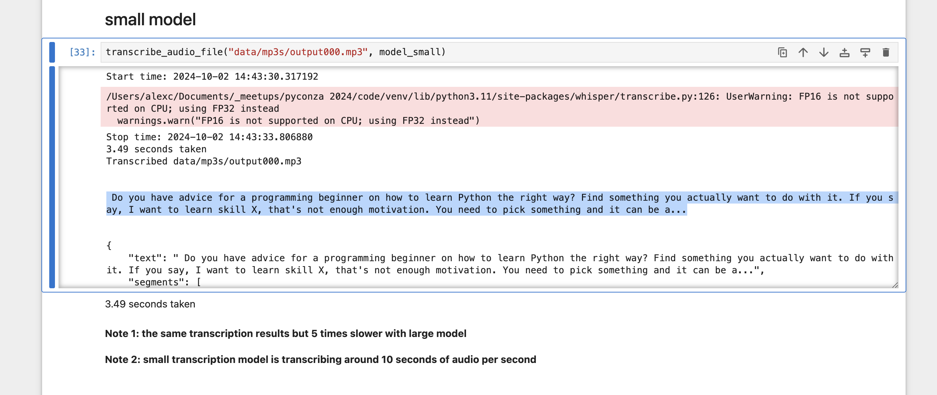

Slide 56
Jupyter Notebook
Emotion Recognition.ipynb

Slide 59
Speech Data
Todo
https://github.com/mbamvianney/SPEECH-EMOTION-RECOGNITION-WITH-MACHINE-LEARNING

Slide 61
Text Data

Slide 62
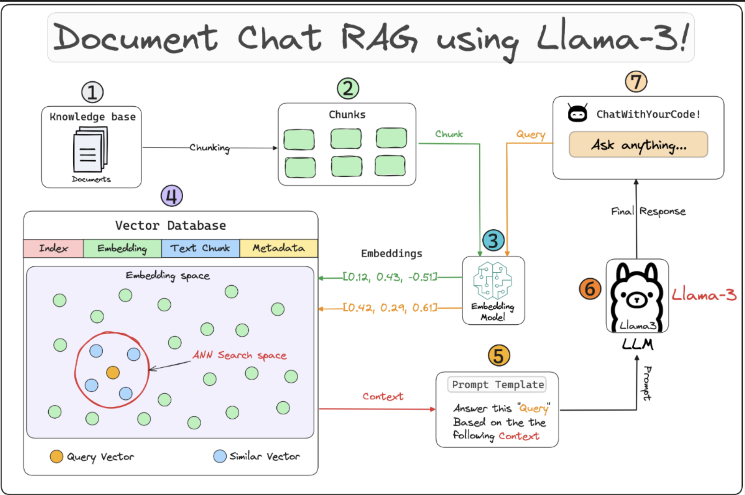
lightning.ai/lightning-ai/studios/rag-using-llama-3-2-by-meta-ai

Slide 63
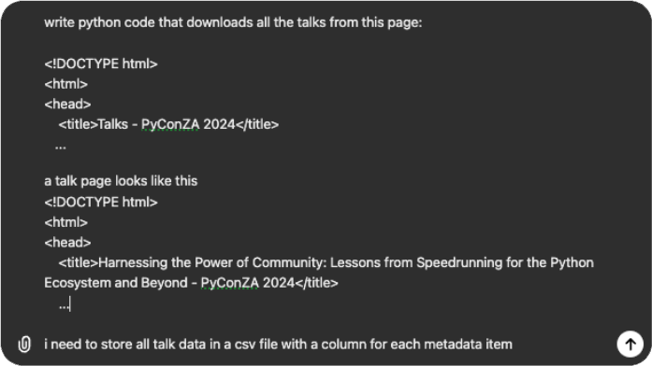
talks.html
talk.html

Slide 64
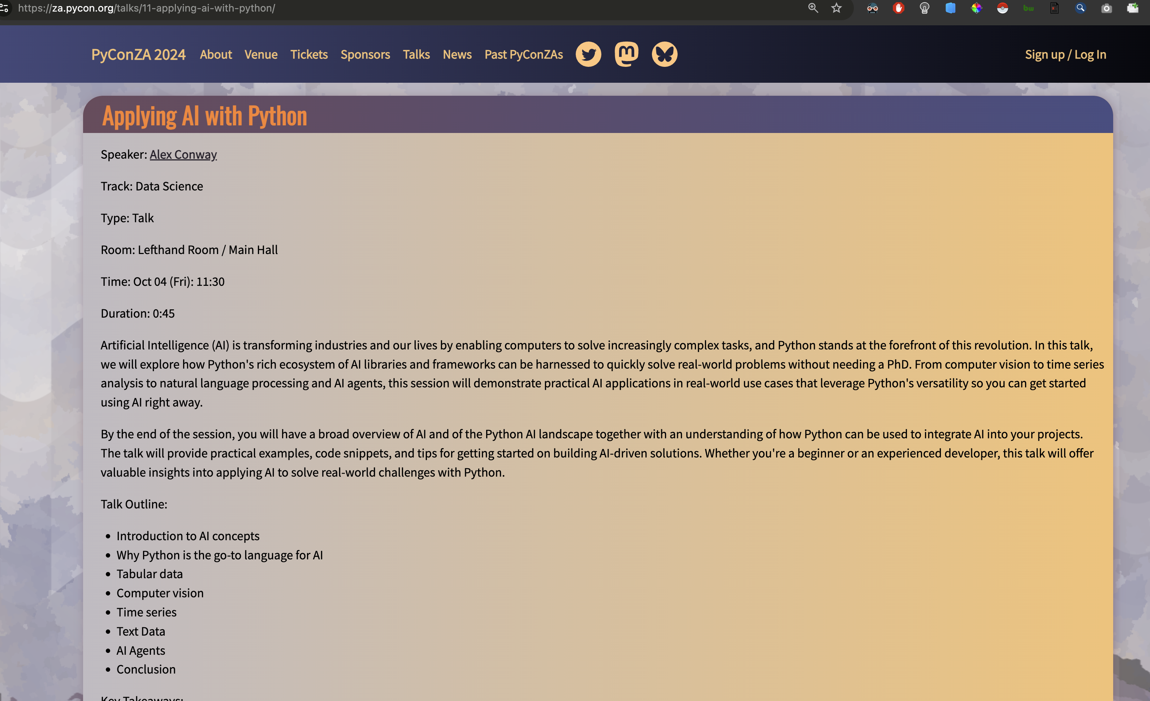

Slide 65
Jupyter Notebook
Scrape PyConZA2024.ipynb

Slide 66
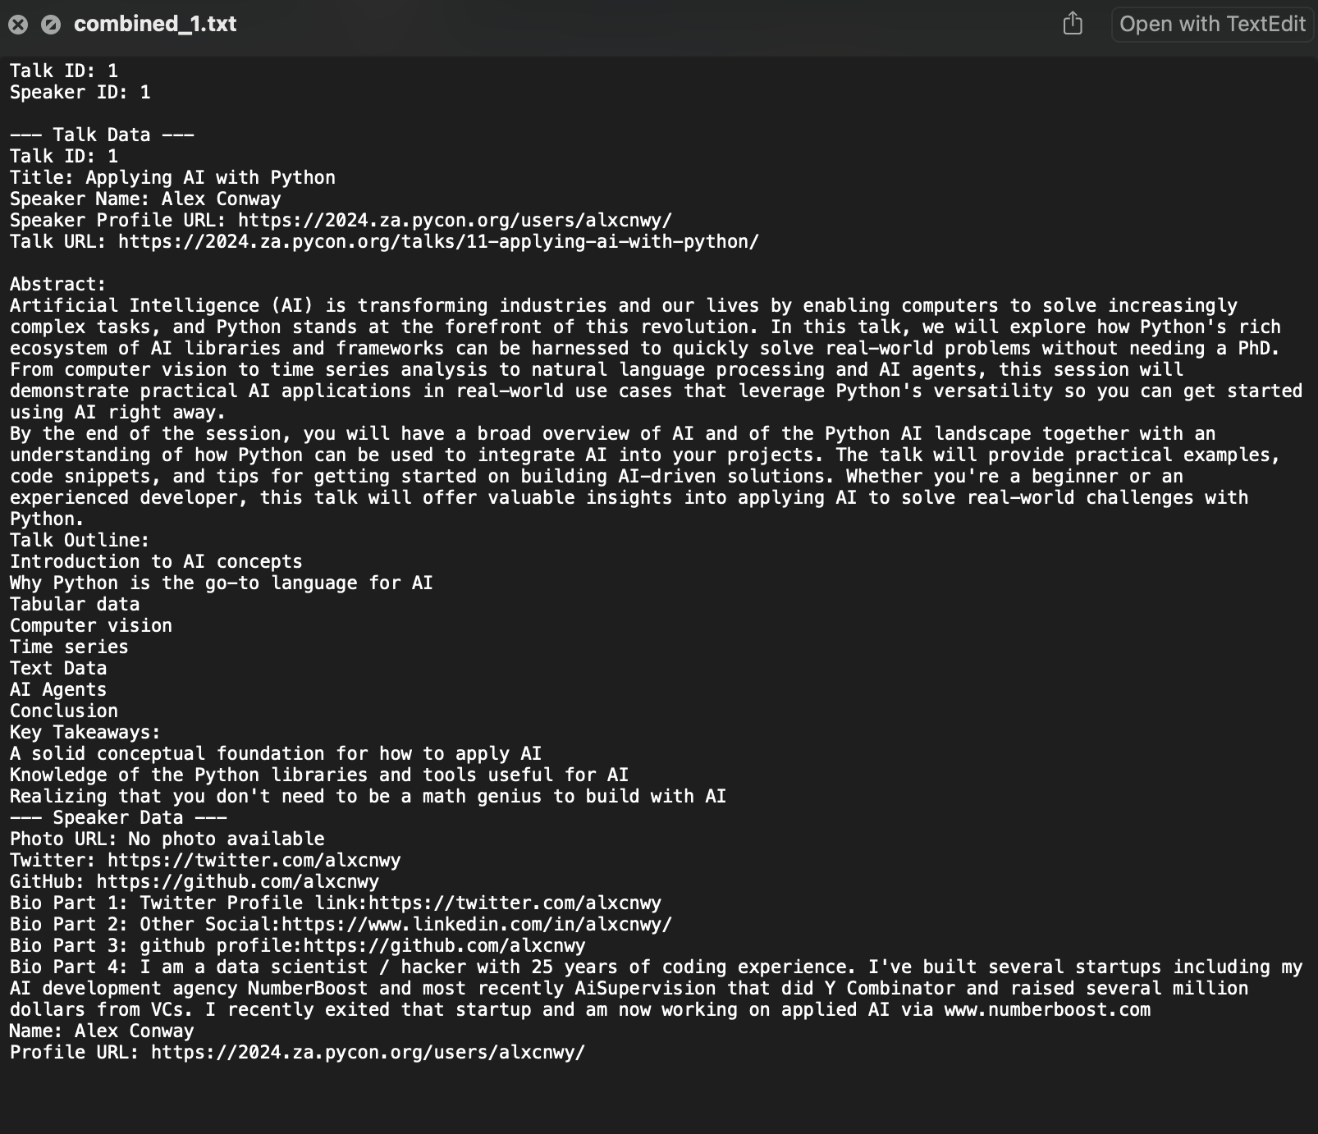

Slide 67
Jupyter Notebook
ETL – Load Documents into Database.ipynb

Slide 68
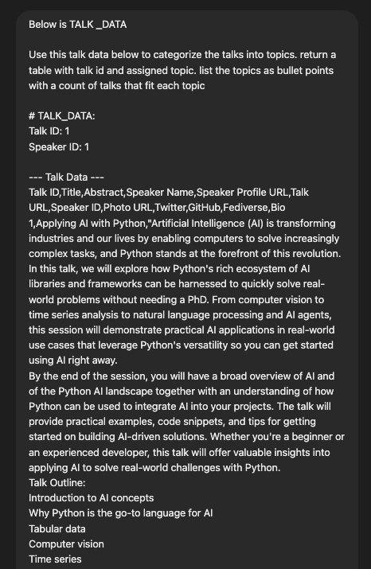
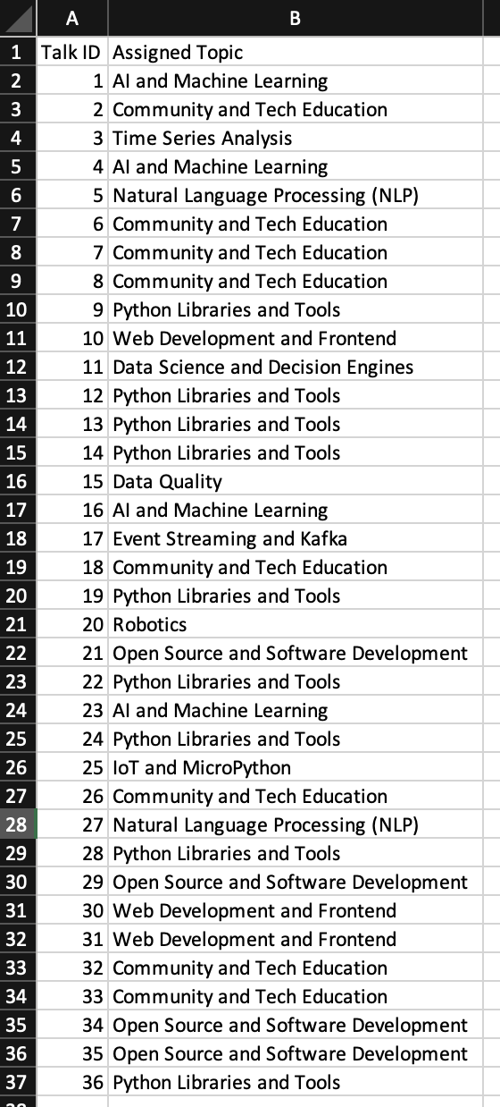

Slide 70
AI Agents

Slide 71
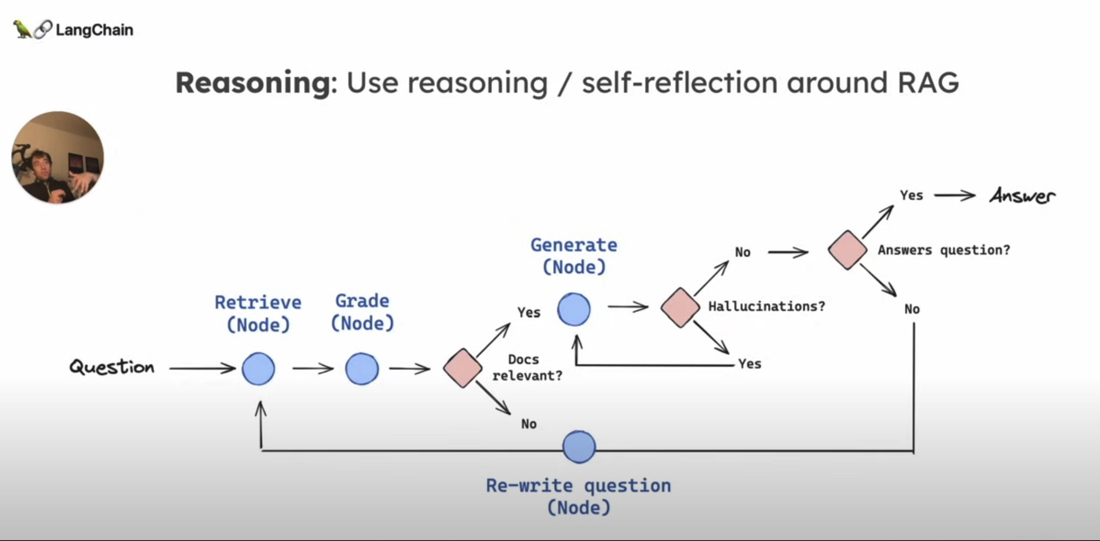

Slide 72
AI Agents
RAG with SQL and function calling?

Slide 76
Conclusion

Slide 77
def ai_model(input):
#
# algorithms f(input) = output
#
return output

Slide 78
Chatgpt screenshot with terminology example

Slide 79
Thank You!
Alex Conway
alex@numberboost.com
x.com/alxcnwy

